Slide 1

XOR-Based File Encryption and Decryption using Assembly Language (64-bit NASM)
Submitted by:
Waqar Ahmed | 1367
Wilayat Ali | 1407
Sohail | 1362
Shabbir Hussain | 1361
Instructor:
Mr.Sajid Ali
Tools:
NASM, GoLink, Windows API

Slide 2


Introduction
This project implements file-level encryption using XOR logic.
It encrypts data from an input file and writes it to an output file.
Running the same program again decrypts it using the same key.
Demonstrates low-level file handling using Windows API.

Slide 3
Project Objective
1
To understand encryption/decryption mechanisms at the assembly level.
2
To learn how to use Windows API functions for file I/O.
3
To apply XOR logic for data protection.
4
To perform practical encryption using NASM in 64-bit mode.

Slide 4




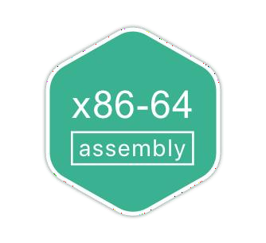
Tools & Technologies
Assembler: NASM (Netwide Assembler)
Linker: GoLink Libraries: msvcrt.dll System: Windows 64-bit
Language: Assembly (x86-64 syntax)

Slide 5
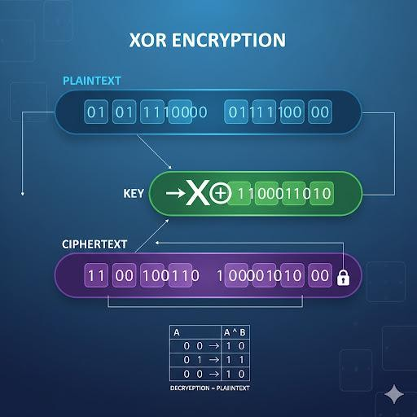
Concept of XOR Encryption
XOR = Exclusive OR (bitwise operation)
Works as:
1 XOR 0 = 1, 0 XOR 1 = 1, 1 XOR 1 = 0,
0 XOR 0 = 0
Symmetric Encryption:
(Data XOR Key) XOR Key = Original Data
Same logic performs encryption and decryption.

Slide 6

Encryption Algorithm (Step-by-Step)
Open input.txt for reading
Create output.txt for writing
Read data block (e.g., 4KB)
Perform XOR with the key
Write encrypted block to output file
Repeat until EOF
Close files

Slide 7
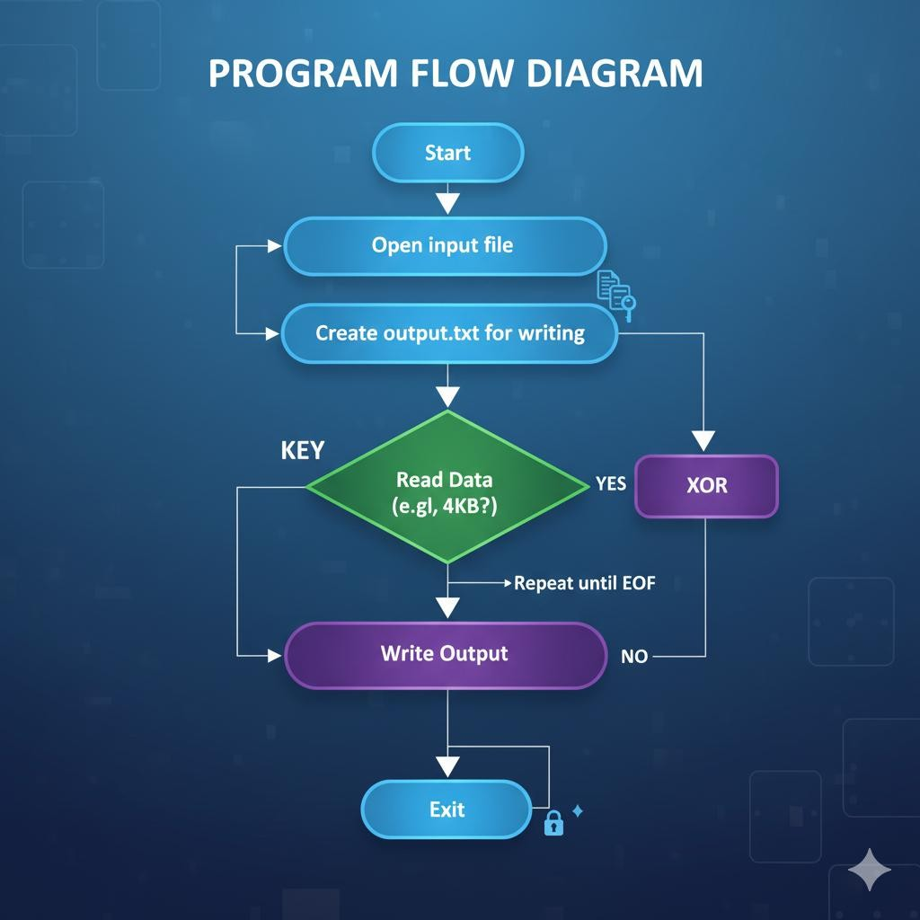
Program Flow Diagram
Start → Open input file → Create output file → Read Data → XOR → Write Output → Repeat until EOF → Close Files → Exit

Slide 8
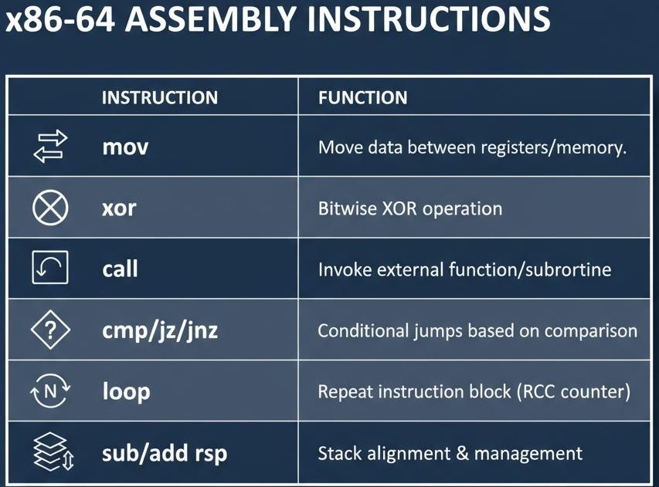
Key Assembly Instructions
mov – Move data between registers
xor – Perform XOR encryption call – Invoke external function cmp/jz/jnz – Conditional jumps loop – Repeat instruction block sub/add rsp – Stack alignment

Slide 9
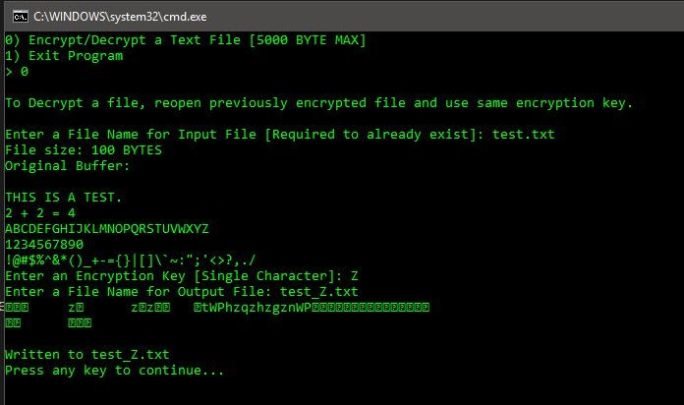
Code Overview
Main Sections:
.data — stores messages and file names
.bss — buffers and variables
.text — logic for reading, encrypting, writing
Uses printf, scanf, fopen, fread, fwrite, fclose

Slide 10

Encryption Code Example
mov rsi, buffer
mov rcx, rax
mov al, [key]
xor_loop:
xor byte [rsi], al
inc rsi
loop xor_loop
Each byte is XOR-ed with the key. Running again decrypts it.

Slide 11

Input/Output Examples
Before Encryption (input.txt): Hello World
After Encryption (output.txt):
Zgssf#T^oo[
After Running Again (Decrypted):
Hello World

Slide 12

Challenges Faced
× 64-bit stack alignment issues (rsp alignment)
× Windows calling convention handling
× Closing file handles properly
× Taking user inputs correctly

Slide 13

Results & Achievements
Successfully implemented 64-bit Assembly
encryption
Verified correct encryption/decryption using XOR
Used Windows API for file handling
Created interactive user input version

Slide 14

Conclusion & Future Work
Demonstrated low-level encryption using NASM
Learned about registers, loops, file I/O
Future work:
Multi-character keys AES/DES algorithms GUI interface

Slide 15
Thank you
Do you any Question?

